Slide 1
COMP 2710 Software Construction
Arrays
Dr. Xiao Qin
Auburn University
http://www.eng.auburn.edu/~xqin
xqin@auburn.edu
Spring, 2012
These slides are adapted from notes by Dr. Walter Savitch (UCSD)
Notes:
See also Lec05a.ppt in Fall’09 and Fall’11

Slide 2
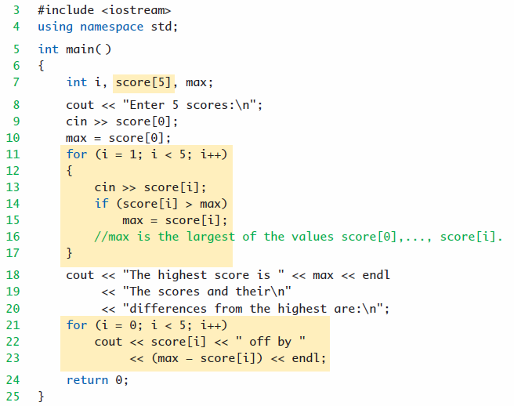

Explain the Following Array Program
What is the output?
5-<number>
Notes:
maxscore.cpp

Slide 3
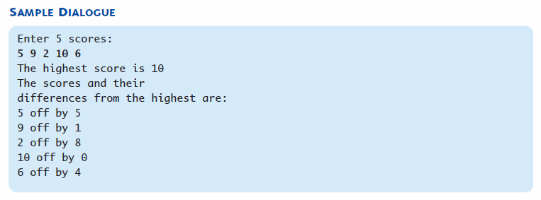
Array Program Example
5-<number>

Slide 4
Try this. What will happy?
Any suggestion?
6
5-<number>
Notes:
Indexes range from 0 to (array_size – 1)
Example:
double temperature[24]; // 24 is array size
// Declares array of 24 double values called
temperature
They are indexed as:
temperature[0], temperature[1] … temperature[23]
Common mistake:
temperature[24] = 5;
Index 24 is "out of range"!
No warning, possibly disastrous results
Always use defined/named constant for array size
const int NUMBER_OF_STUDENTS = 5;
int score[NUMBER_OF_STUDENTS];
If size changes → requires only ONE change in program!

Slide 5
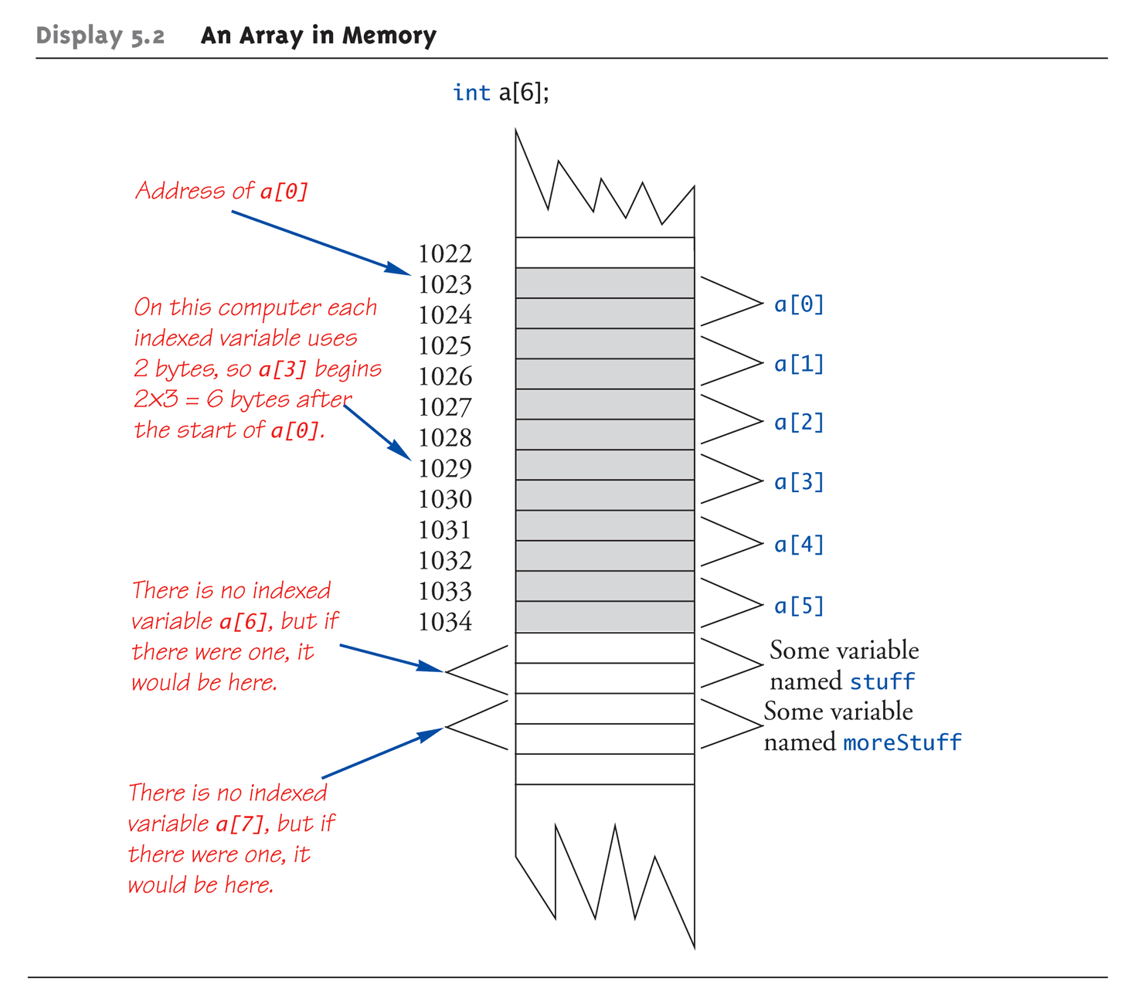
An Array in Memory
Copyright © 2008 Pearson Addison-Wesley. All rights reserved.
5-<number>

Slide 6
Initializing Arrays
As simple variables can be initialized at
declaration:
int price = 0; // 0 is initial value
Arrays can as well:
int children[3] = {2, 12, 1};
  Equivalent to following:
  int children[3];
  children[0] = 2;
  children[1] = 12;
  children[2] = 1;
Copyright © 2008 Pearson Addison-Wesley. All rights reserved.
5-<number>

Slide 7
Auto-Initializing Arrays
If fewer values than size supplied:
  Fills from beginning
  Fills "rest" with zero of array base type
If array-size is left out
  Declares array with size required based on
  number of initialization values
  Example:
  int b[] = {5, 12, 11};
    Allocates array b to size 3
Copyright © 2008 Pearson Addison-Wesley. All rights reserved.
5-<number>

Slide 8
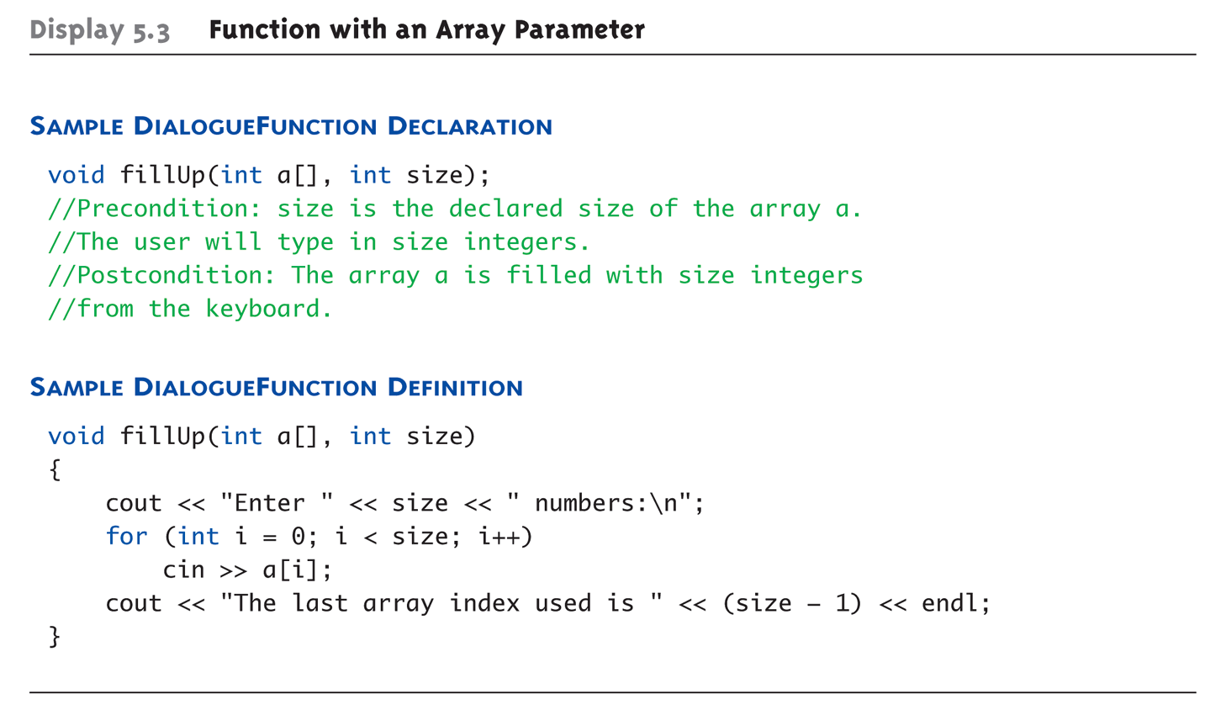

Entire Array as Argument
How to call the function? Give me an example?
  Note no brackets in array argument!
5-<number>
Notes:
fillup.cpp
As arguments to functions
Indexed variables
An individual "element" of an array can be
function parameter
Entire arrays
All array elements can be passed as
"one entity"
As return value from function
Can be done → chapter 10
Formal parameter can be entire array
Argument then passed in function call
is array name
Called "array parameter"
Send size of array as well. Why?
Typically done as second parameter
Simple int type formal parameter
Note no brackets in array argument!

Slide 9
Array as Argument
What’s really passed?
Think of array as 3 "pieces"
  Address of first indexed variable (arrName[0])
  Size of array
  Array base type
Why the type is important?
5-<number>

Slide 10

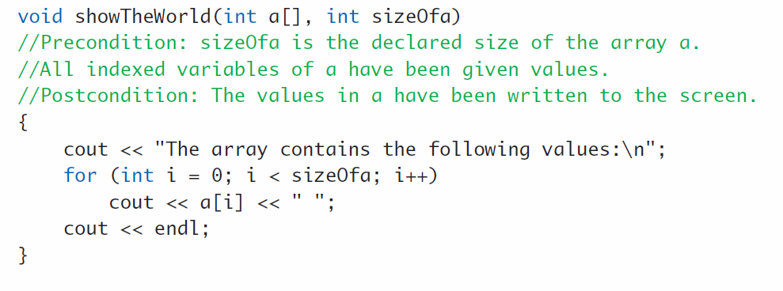
Why the function can modify array?
Only 1st piece is passed!
  Just the beginning address of array
  Very similar to "pass-by-reference"
How to protect array contents from modification?
  Use "const" modifier before array parameter
    Called "constant array parameter"
    Tells compiler to "not allow" modifications
5-<number>

Slide 11
Programming with Arrays
Plenty of uses
  Partially-filled arrays
    Must be declared some "max size"
  Sorting
  Searching
Copyright © 2008 Pearson Addison-Wesley. All rights reserved.
5-<number>

Slide 12
Partially-filled Arrays
Difficult to know exact array size needed
Must declare to be largest possible size
  Must then keep "track" of valid data in array
  Additional "tracking" variable needed
    int numberUsed;
    Tracks current number of elements in array
Copyright © 2008 Pearson Addison-Wesley. All rights reserved.
5-<number>

Slide 13
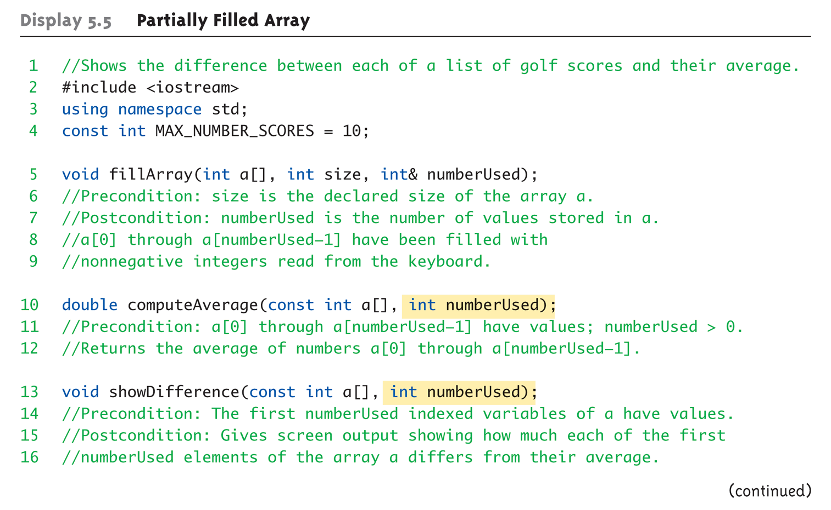
Partially-filled Arrays
Exercise: Write a main() function calling the following functions
5-<number>
Notes:
partialarray.cpp

Slide 14
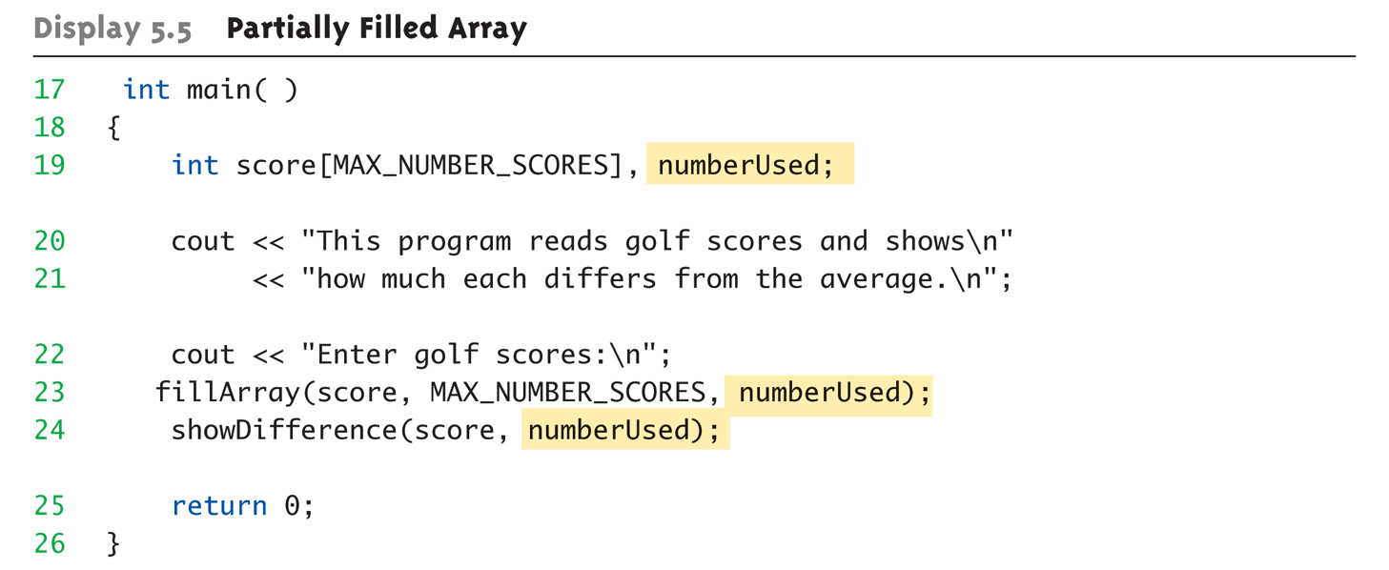
Partially-filled Arrays Example:
Copyright © 2008 Pearson Addison-Wesley. All rights reserved.
5-<number>

Slide 15
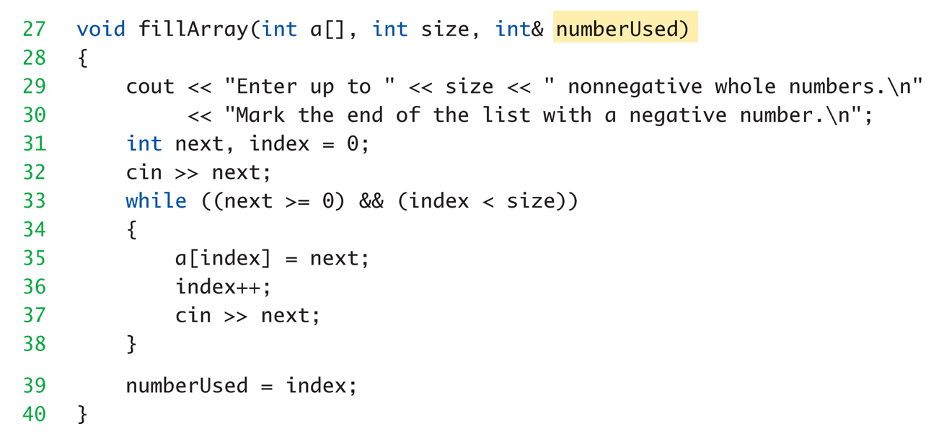
Exercise: Implement the fillArry() function
Copyright © 2008 Pearson Addison-Wesley. All rights reserved.
5-<number>

Slide 16
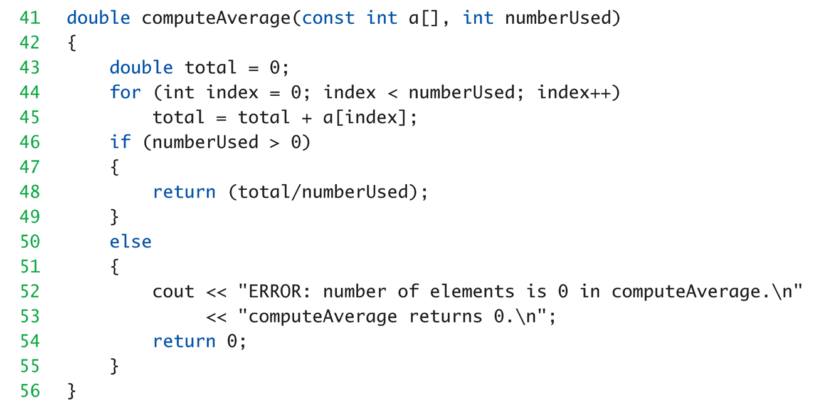
Can you implement the computeAverage() function?
Copyright © 2008 Pearson Addison-Wesley. All rights reserved.
5-<number>

Slide 17
Global Constants vs. Parameters
Constants typically made "global"
  Declared above main()
Functions then have scope to array
size constant
  No need to send as parameter then?
    Technically yes
  Why should we anyway?
Function definition might be in separate file
Function might be used by other programs!
Copyright © 2008 Pearson Addison-Wesley. All rights reserved.
5-<number>

Slide 18
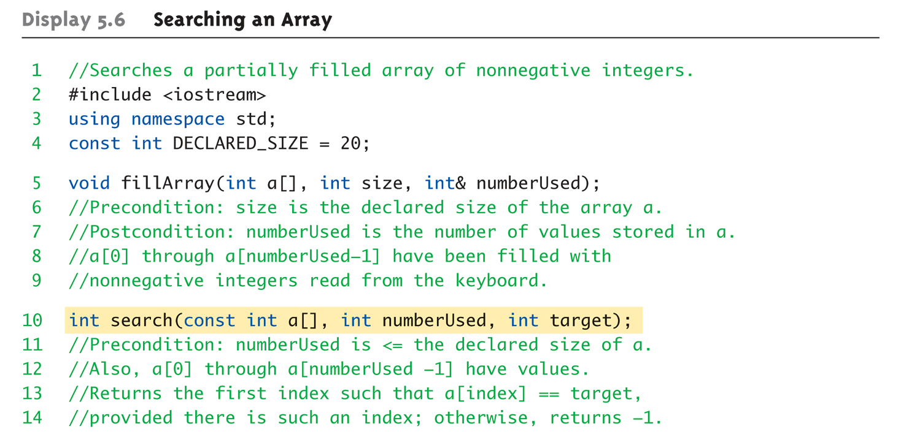
Searching an Array
Copyright © 2008 Pearson Addison-Wesley. All rights reserved.
5-<number>
Notes:
searcharray.cpp

Slide 19
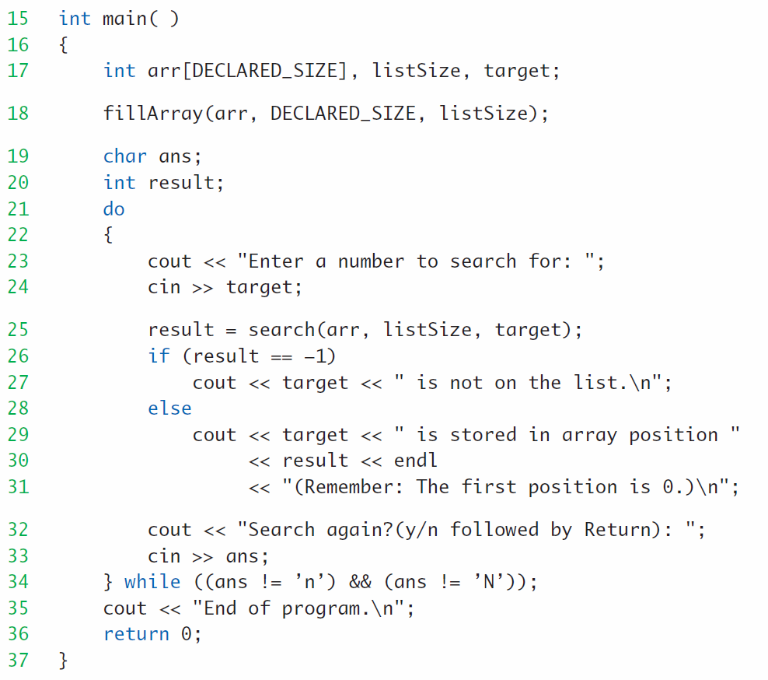
Searching an Array (cont.)
Copyright © 2008 Pearson Addison-Wesley. All rights reserved.
5-<number>

Slide 20
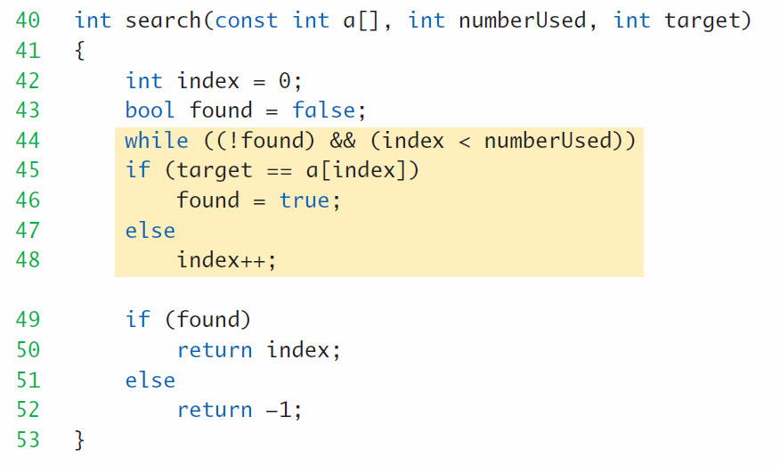
Exercise: Implement the search() function
Copyright © 2008 Pearson Addison-Wesley. All rights reserved.
5-<number>

